Slide 1
TicketSlackers by the TicketTeam
Muhammad, Akash, Dylan, Brian, Rafael, Thang, Adam

Slide 2

Objective
To create a web app that people can use to view different tickets available in their area.
Additionally, to have the functionality to share and subscribe to different types of tickets.
Built on the TicketMaster open source API.

Slide 3
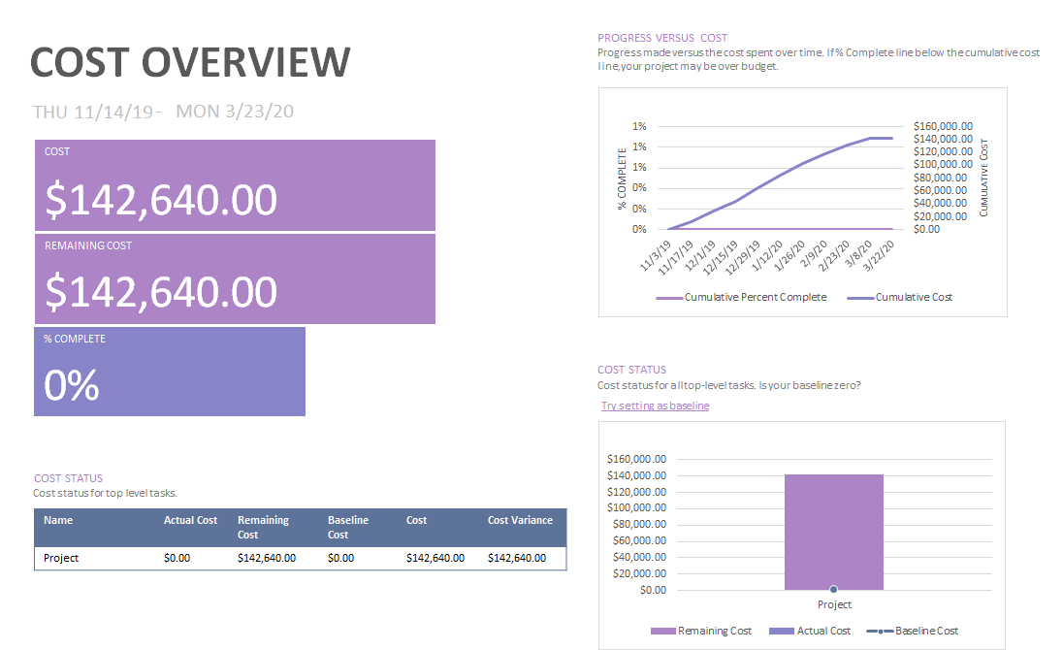
Cost estimation

Slide 4
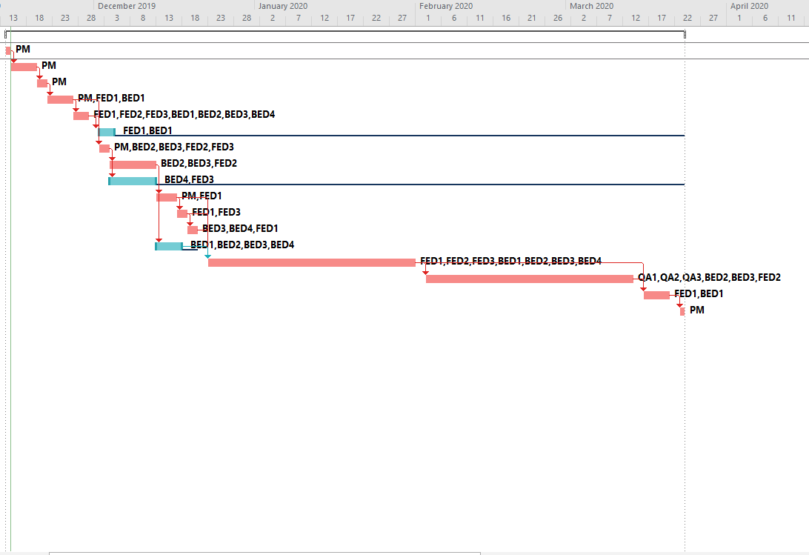
Project timeline

Slide 5

Functional Requirements
Homepage UI
Event search and MoneyShot
Event Search engine using Ticket Masters API
Criteria
Zip Code
City
Date range
Artist
Venue/event

Slide 6
Functional Requirements
Subscribe to Artist/Event
Updated pricing available
Unsubscribe option
Display of event
show availability (sold out or not)
prices (general admission, VIP, VIP+, etc.)
official ticket vendor link.
MoneyShot Search engine
Display price comparisons from first party and third party vendors
Share event via Social media

Slide 7

Main Non-Functional Requirements
Organizational Requirements: Users will provide their phone numbers when they wish to subscribe to receive notifications for events pertaining a specific artist.
Efficiency: Results should be delivered under one tenth of a second.
Dependability: The TicketTeam application can recommend events to the user at all times.
Security: Phone numbers are encrypted in the database
Usability: Color-blindness option.

Slide 8
Main Non-Functional Requirements
Regulatory: Making sure all of our third party ticket vendors are still trustworthy every week
Ethical: Providing accurate ticket prices.
Legislative: TicketTeam will uphold copyright infringement laws for all artists.
Accounting requirements: app is free to use, but we would run ads to generate revenue.
Safety/Security: All ticket recommendations are from trusted vendors.

Slide 9
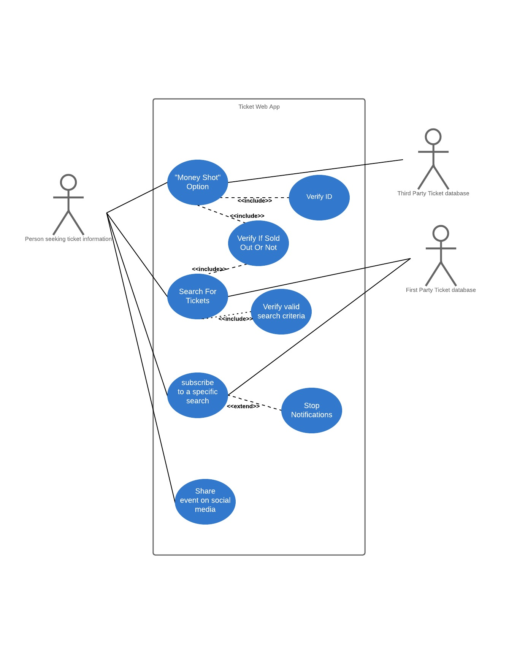
Use Case Diagram
The user has the option to:
Search for tickets
Select “money shot” option
Subscribe for a specific search criteria
Or share an event

Slide 10
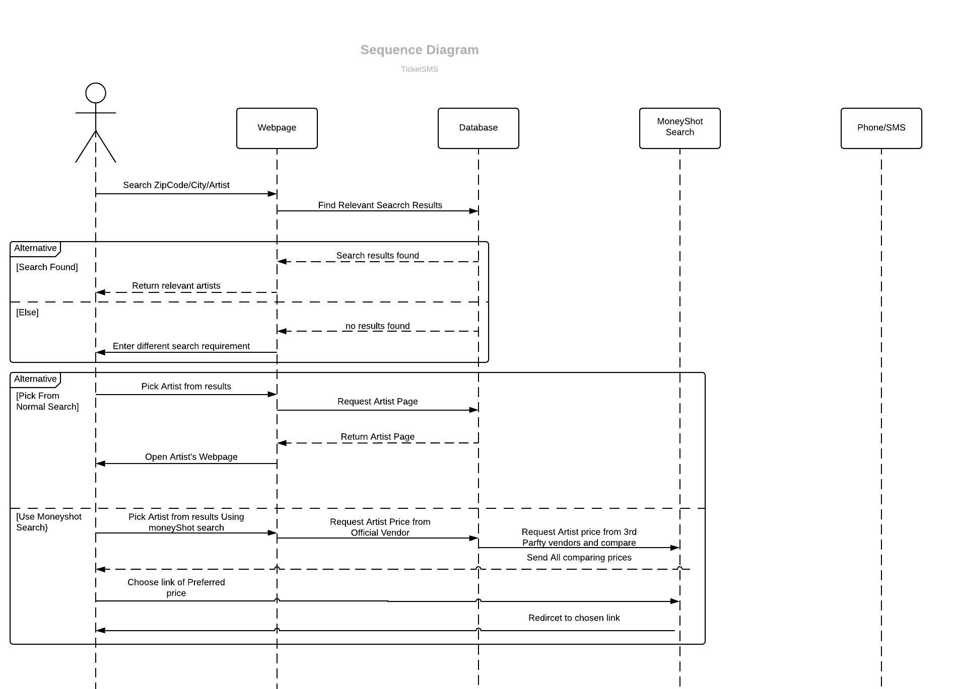
Sequence Diagram
Two specific cases
Recurring user
Guest user
Diagram 1 depicts guest user experience
Limitation
Access to Moneyshot search limited
Unable to subscribe to artist

Slide 11
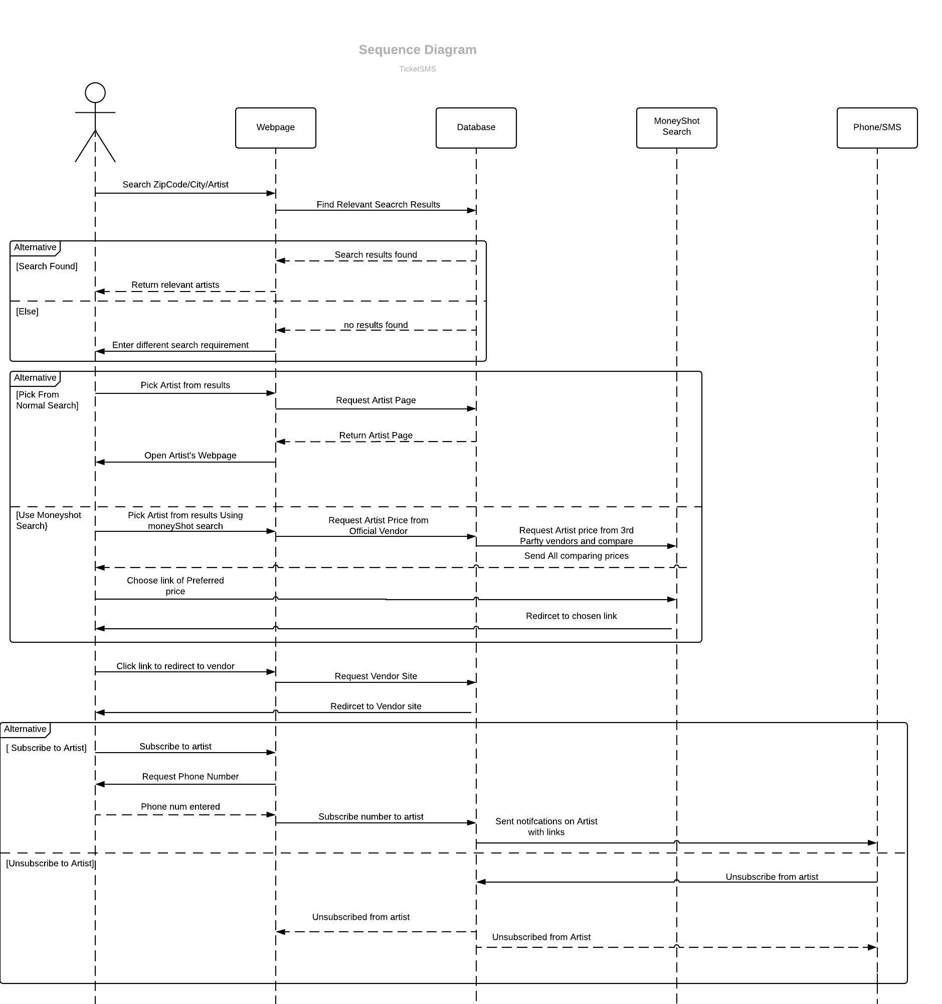
Sequence Diagram(2)
Second case: Recurring User
Access to all features of the Service.
Depicts MoneyShot Search and subscription feature fully.

Slide 12
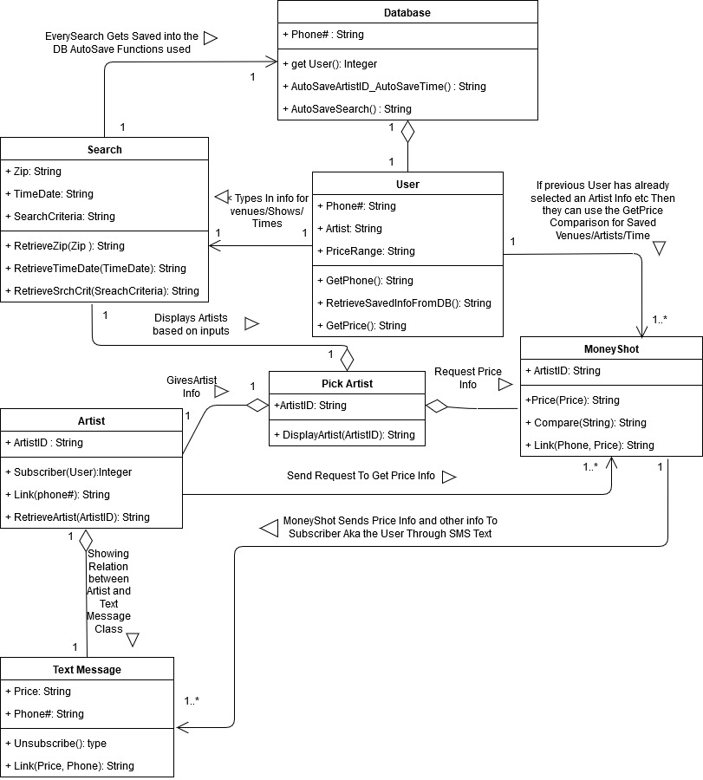
Class Diagram
Functionality separated into multiple classes.
Each class represents attributes and methods respectively.
Detailed inheritance and relationships between classes.
‘User’ is an instance of DB
‘Pick Artist’ has multi-tiered relationships between classes

Slide 13
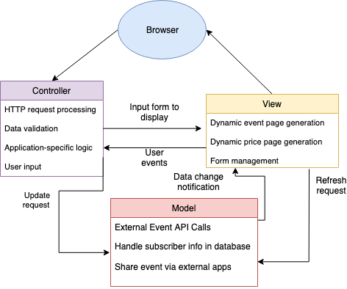
MVC Architectural Design
MVC consists of 3 logical interactive components.
Model -> Backend handling
View -> Frontend handling
Controller -> Handles interactivity
By Splitting functionality into groups it promotes organized Development

Slide 14
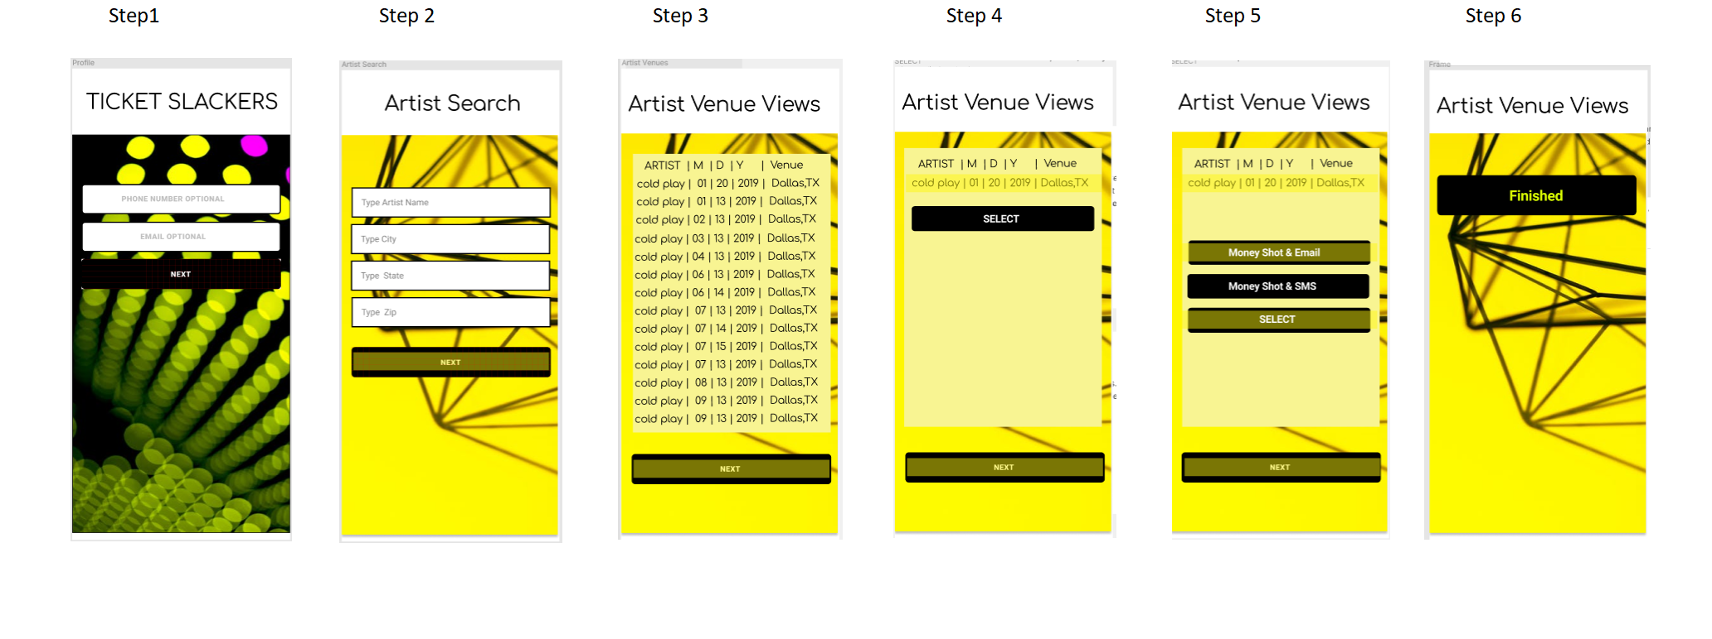
UI Screens

Slide 15
Conclusion: Ticketmaster Challenges & Achievements
Challenges
Deciding on an API for the foundation of our service.
Keeping the user interface with the system simple and easy to understand despite the multi-layered software architecture.
Deciding between choosing Model View Controller (MVC) or Repository pattern.
Achievements
We were able to efficiently communicate with each other.
We also gained a valuable experience during various stages of software designing and learned tools that helped us visualize the functions of our software.
We were able to make an educated cost and development prediction.

